Slide 1
Epidemiology at a Local Health Department
Peter Banwarth
Benton County Health Department
2/27/2019

Slide 2
Population Health Epidemiology
The goal of population health epidemiology is to learn about
our community
its health status, and
the key determinants of health
then to use that knowledge
to support the work of the public health department, and
to share that knowledge with our community.

Slide 3
Population Health Epidemiology
The goal of population health epidemiology is to learn about
our community
its health status, and
the key determinants of health
then to use that knowledge
to support the work of the public health department, and
to share that knowledge with our community.
Let’s do it!

Slide 4
What percent of Corvallis residents are between the ages of 18 and 24?
12%
20%
28%
40%

Slide 5
What percent of Corvallis residents are between the ages of 18 and 24?
12%
20%
28%
40%
28%

Slide 6
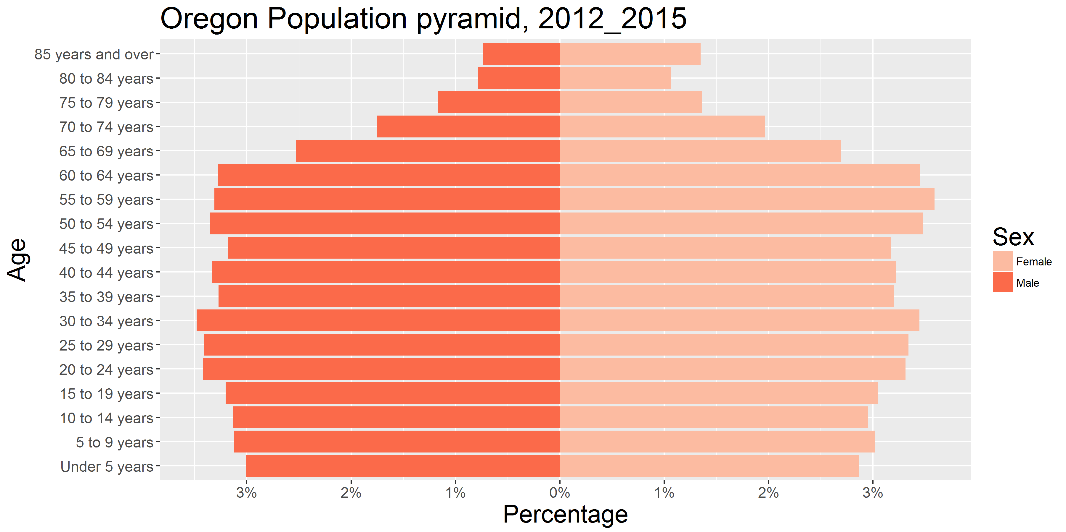
A typical population pyramid (Oregon, 2015)

Slide 7
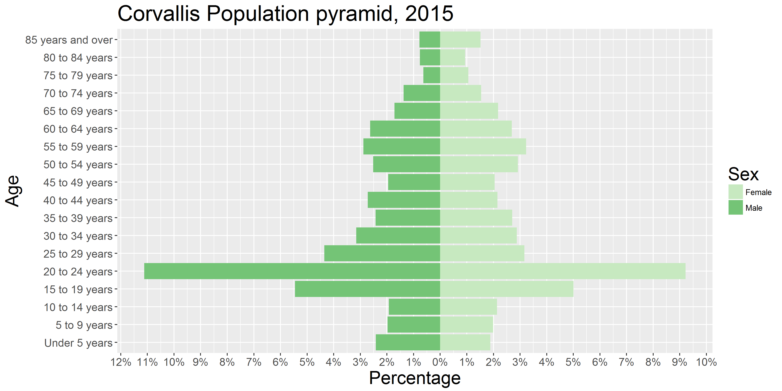
Corvallis’ population pyramid, 2015

Slide 8
One consequence of OSU:
Corvallis has the highest poverty rate among the 18 Oregon cities with at least 30,000 residents.
Corvallis has the sixth lowest poverty rate among the 18 Oregon cities with at least 30,000 residents, when individuals aged 18-24 are excluded from the calculation.

Slide 9
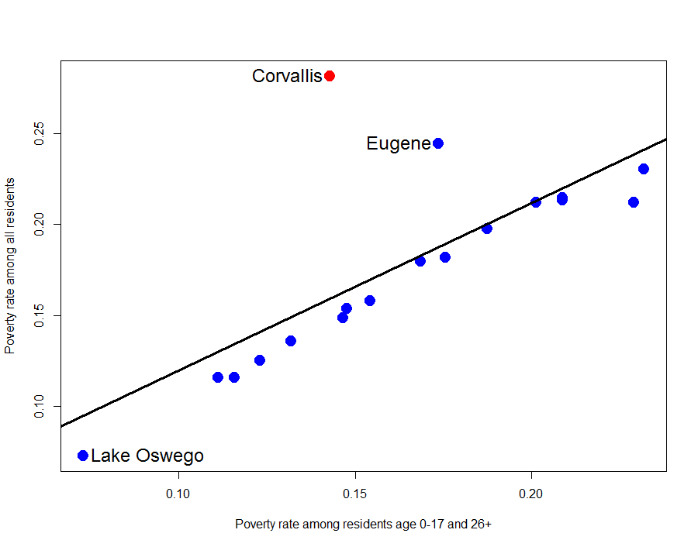

Slide 10
Fill in the blank: _____ Corvallis residents identify as non-white, and _____ Corvallis students identify as non-white.
1 in 10 … 1 in 10
3 in 5 … 2 in 5
1 in 5 … 1 in 3
1 in 4 … 1 in 2

Slide 11
Fill in the blank: _____ Corvallis residents identify as non-white, and _____ Corvallis students identify as non-white.
1 in 10 … 1 in 10
3 in 5 … 2 in 5
1 in 5 … 1 in 3
1 in 4 … 1 in 2
1 in 5 … 1 in 3

Slide 12
Corvallis is becoming more diverse over time
In 2015, 31% of Corvallis K-12 students identified as non-White
At Lincoln Elementary School, 44% of students identified as non-White, and
At Garfield Elementary School, 58% of students identified as non-White.
In 2000, approximately 10% of residents identified as either non-White or Hispanic/Latino
In 2015, 20% of residents identified as either non-White or Hispanic/Latino

Slide 13
Since 2000, what percent of housing construction has been built for the rental market (through 2015)?
50%
60%
75%
90%

Slide 14
Believe it or not…
Approximately 50% of buildings constructed between 2000 and 2015 are occupied by renters, but
58% of buildings constructed before 2000 are occupied by renters
In fact, 3/5 of rental properties in Corvallis were built before 1980

Slide 15
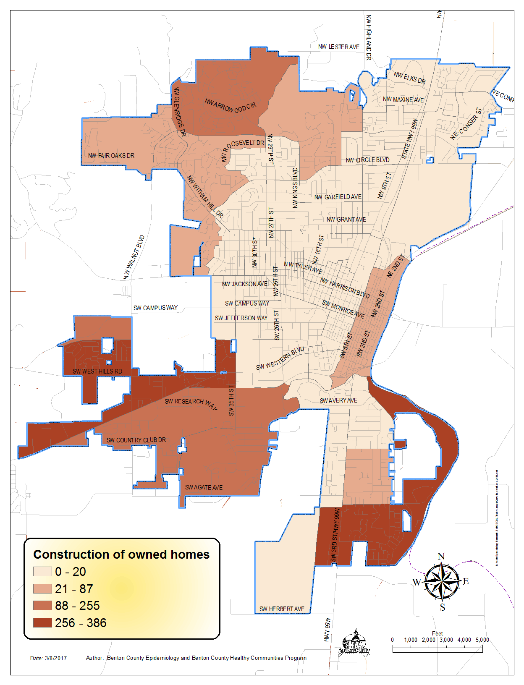
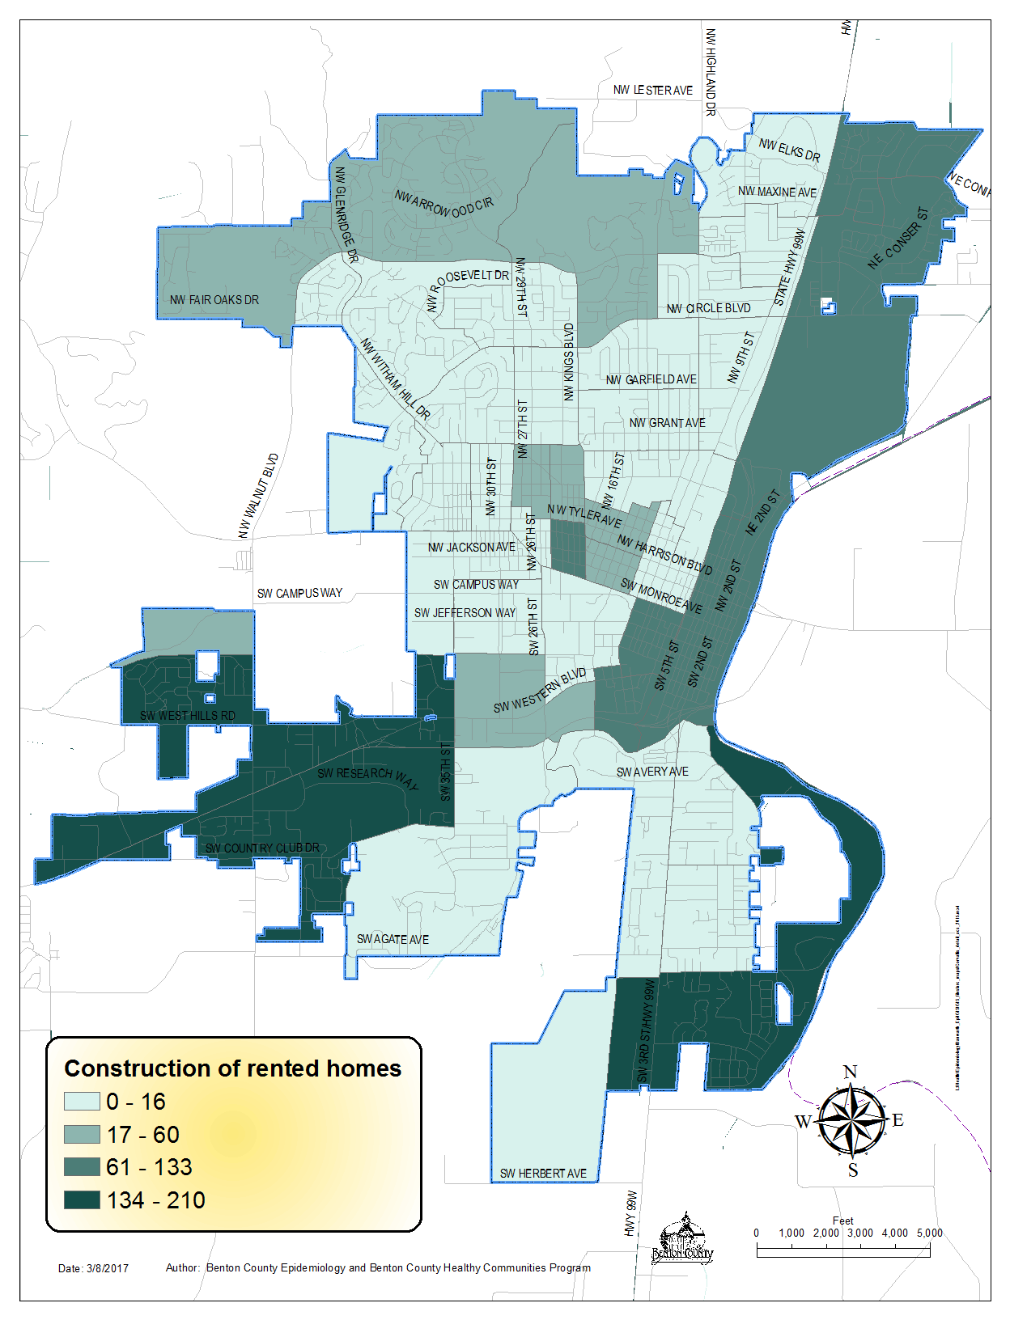
Owned homes built 2000-2015
Rented homes built 2000-2015

Slide 16
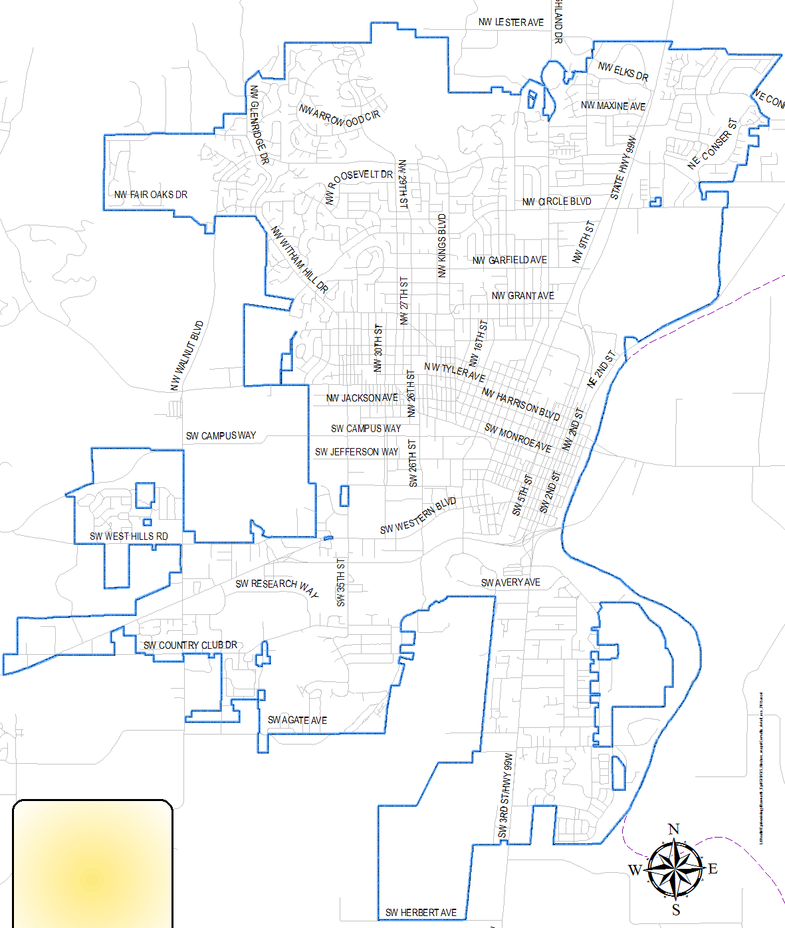
Which neighborhood has the highest percentage of low-income families?
Northwest Corvallis
Northeast Corvallis
Central Corvallis
Southwest Corvallis
South Corvallis

Slide 17
Which neighborhood has the highest percentage of low-income families?
Central Corvallis

Slide 18
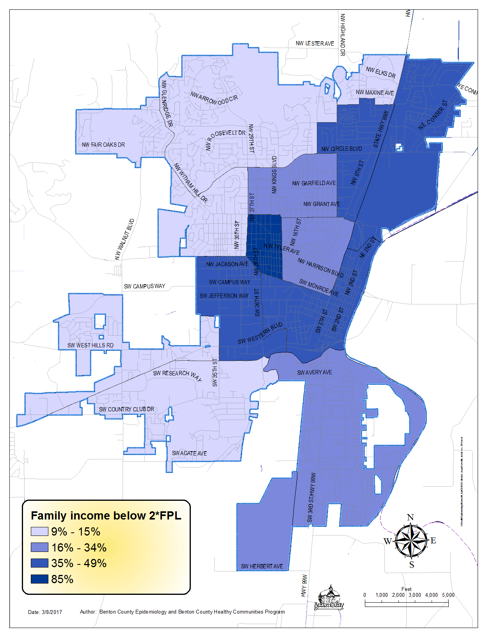
85% of families in the neighborhood near Chintimini Park live with incomes below twice the Federal Poverty Level
Northeast and Central Corvallis are generally low income
Northwest and Southwest Corvallis have very low family poverty rates (less than 11%)
Poverty rates vary within these census tract boundaries

Slide 19
What percent of households headed by residents identifying as Hispanic or Latino are owned?
11%
22%
33%
44%
55%

Slide 20
What percent of households headed by residents identifying as Hispanic or Latino are owned?
11%
22%
33%
44%
55%
22%

Slide 21
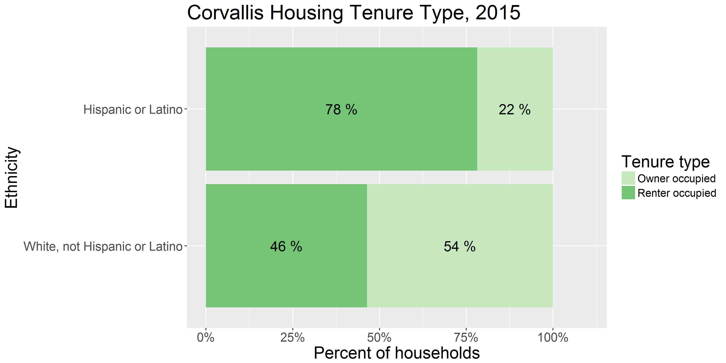
Inequity in home ownership

Slide 22
Communicable Disease Epidemiology
The goal of communicable disease epidemiology is to
ascertain causes of communicable disease,
identify exposed individuals,
limit transmission, and
develop better internal and external procedures to reduce the burden of communicable disease on our population.

Slide 23
Communicable Disease Epidemiology
The goal of communicable disease epidemiology is to
ascertain causes of communicable disease,
identify exposed individuals,
limit transmission, and
develop better internal and external procedures to reduce the burden of communicable disease on our population.
Let’s do it!

Slide 24

E. Coli outbreak at a winery wedding

Slide 25
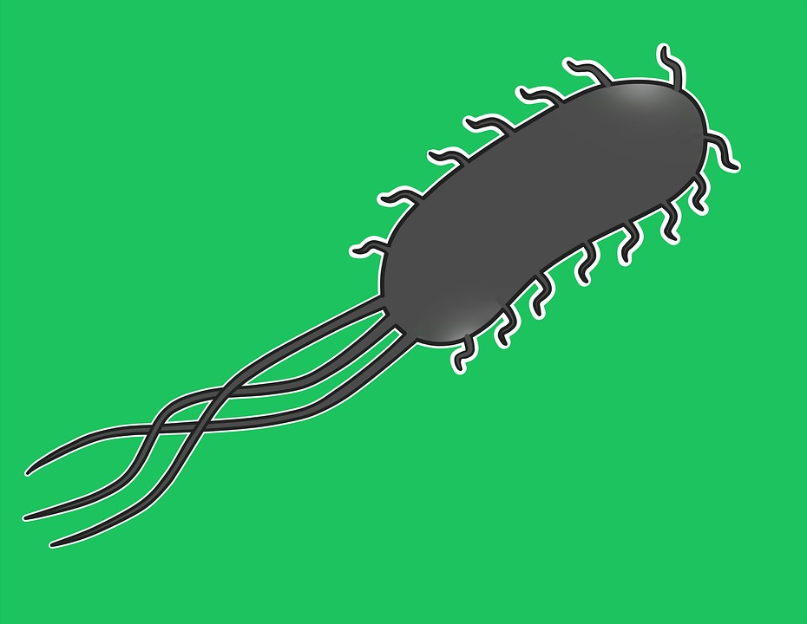
E. Coli outbreak at a winery wedding

Slide 26


August 2018

Slide 27
We get a call from the mother of the bride
“I’m sick, the bride is in the hospital, and a bunch of our guests are sick”

Slide 28
What does an E. Coli infection do?

Slide 29

What does an E. Coli infection do?

Slide 30
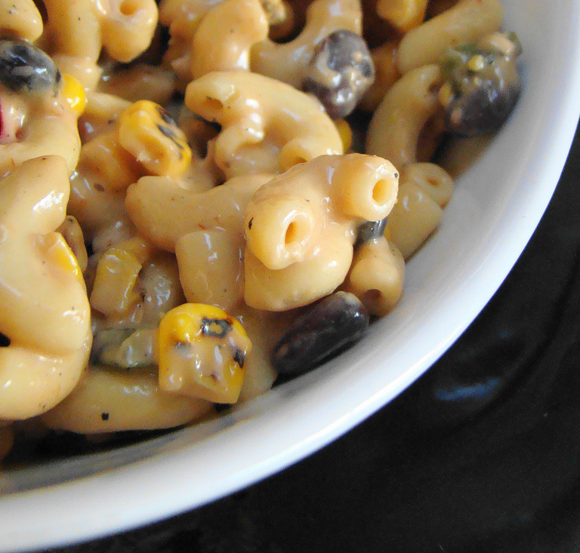
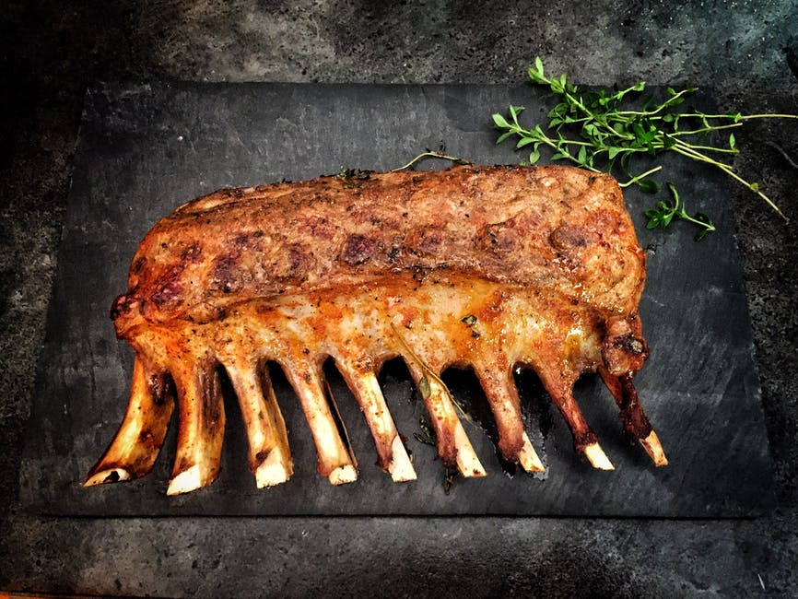
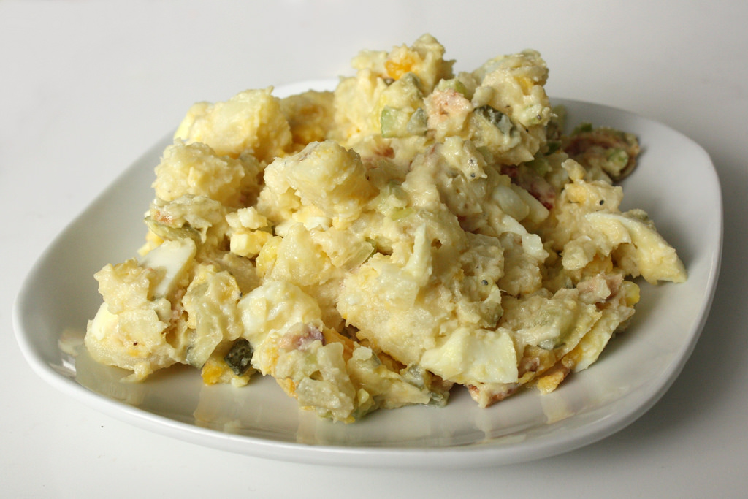
We call the caterer

Slide 31

Not only did they cater the wedding, they also catered the rehearsal dinner.

Slide 32

We start making phone calls

Slide 33
Here’s what we found:
150 wedding guests
54 guests contacted
21 got sick

Slide 34
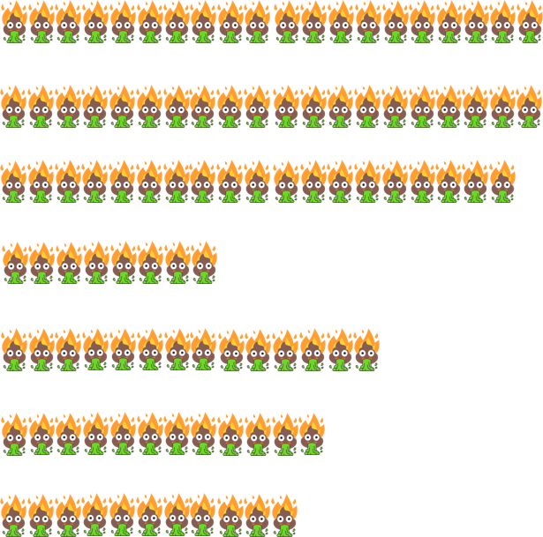

What food(s) could have made people sick?
Wedding
Barbecue Pork
Macaroni Salad
Potato Salad
Crackers
Chicken Fettucine
Caesar Salad
Pineapple
Rehearsal Dinner

Slide 35
Prime suspect: The rehearsal dinner
Dish | Associated with symptoms | Prepared by the caterer |  | Dish | Associated with symptoms | Prepared by the caterer
Chicken Fettucine | ✓ | ✓ |  | Brownie bites | ✓ | ✓
Spaghetti and Meatballs | ✓ | ✓ |  | Lemonade | ✓ | ✓
Caesar Salad | ✓ | ✓ |  | Iced tea | ✓ | ✓
Romaine lettuce | ✓ | ✓ |  | Pineapple | ✓
Parmesan cheese | ✓ | ✓ |  | Cantaloupe | ✓
Croutons | ✓ | ✓ |  | Honeydew | ✓
Garlic bread | ✓ | ✓ |  | Strawberries | ✓
Breadsticks | ✓ | ✓ |  | Chocolate | ✓

Slide 36
But was the rehearsal dinner a red herring?
Dish | Associated with symptoms | Prepared by the caterer |  | Dish | Associated with symptoms | Prepared by the caterer
Chicken Fettucine | ✓ | ✓ |  | Brownie bites | ✓ | ✓
Spaghetti and Meatballs | ✓ | ✓ |  | Lemonade | ✓ | ✓
Caesar Salad | ✓ | ✓ |  | Iced tea | ✓ | ✓
Romaine lettuce | ✓ | ✓ |  | Pineapple | ✓
Parmesan cheese | ✓ | ✓ |  | Cantaloupe | ✓
Croutons | ✓ | ✓ |  | Honeydew | ✓
Garlic bread | ✓ | ✓ |  | Strawberries | ✓
Breadsticks | ✓ | ✓ |  | Chocolate | ✓

Slide 37
But was the rehearsal dinner a red herring?
We interviewed 17 people who attended the rehearsal dinner.
Of those, 15 got sick. Only two did not get sick.
However, we interviewed 6 people who did NOT attend the rehearsal dinner but DID get sick.
 | Attended | Did not attend
Sick | 15 | 6
Not sick | 2 | 31

Slide 38
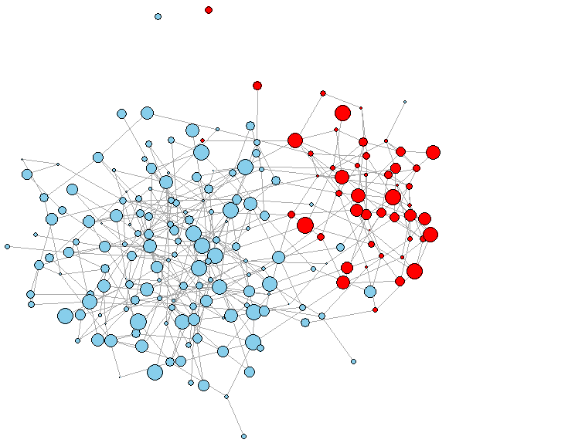
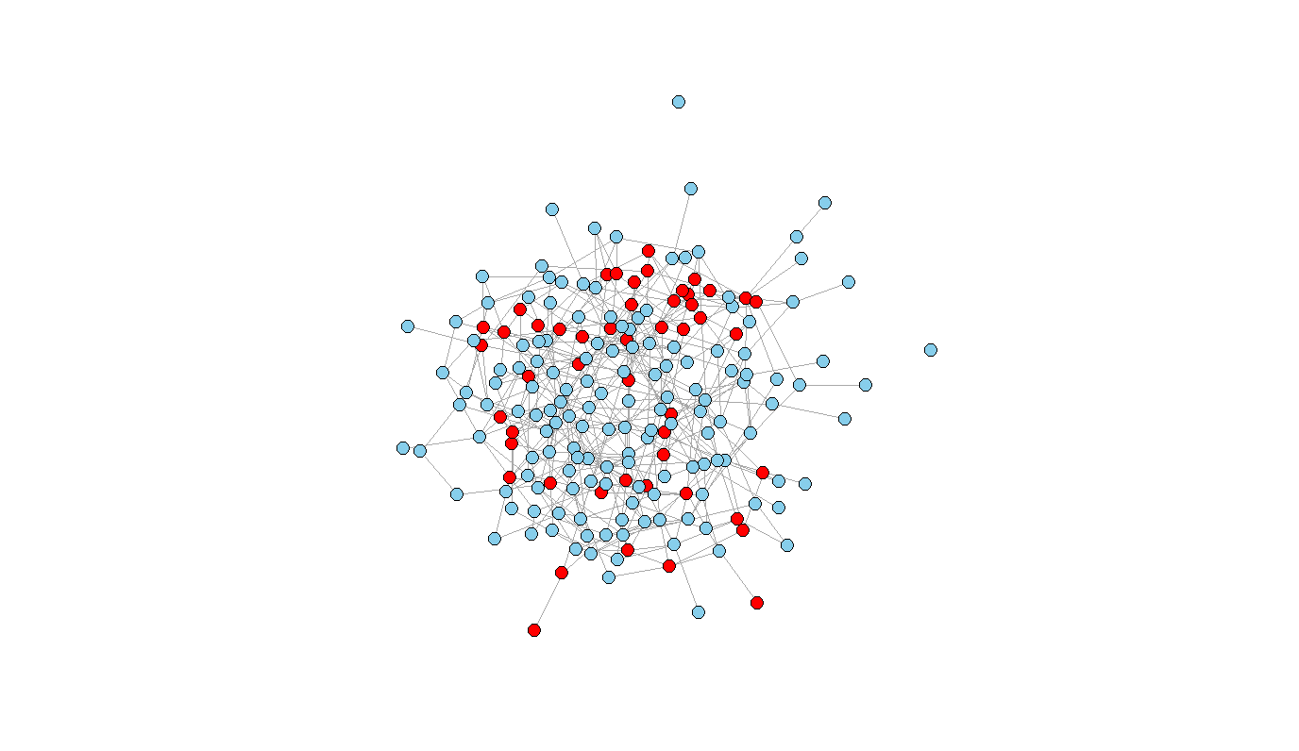
Epidemiology theory
A random population
Epidemiological analysis
Sick
Well
Ate gas station sushi
Did not eat gas station sushi

Slide 39
Epidemiology in practice
Sick
Well

Slide 40
Epidemiology in practice
The large cluster represents the rehearsal dinner attendees
Ate at the rehearsal dinner
Close friends of bride/groom
Went through the wedding buffet at around the same time
We interviewed almost all of them

Slide 41
The bride had saved some leftovers from the wedding. We were able to have them tested for E. Coli.
The potato salad tested positive

Slide 42

We also directly tested the sick guests
7 people agreed to provide a stool sample
3 catering employees tested negative
One wedding guest tested negative
Two wedding guests tested positive
One of these guests did not attend the rehearsal dinner
The catering owner (and head chef) tested positive

Slide 43
So what did we learn?
Most rehearsal dinner attendees got sick
None of the foods from the wedding reception were significantly correlated with symptoms except for the potato salad
At least one case of E. Coli did not attend the rehearsal dinner,
The potato salad from the wedding was positive for E. Coli
The person who had prepared the catered food tested positive
What do you think happened?

